Slide 1
CS 3450
Robust Software
(Especially Communications)

Slide 2
First, Some General Things
A Bit of History
A Bit of Culture
Especially in telecom patterns!

Slide 3
High Availability
99% Uptime
99.9% Uptime
99.99% Uptime
99.999% Uptime
99.9999% Uptime
ALL downtime counts against you!
This is carrier-grade availability

Slide 4
Robust Software
It is basically availability
But includes components of:
Reliability
Performance
Capacity

Slide 5
Reliability
Can you count on the software to do its job?
Accuracy – all the time!
Fault tolerance: if there is a fault (hardware or software), do the right thing
Recover gracefully
Unroll transactions
Shutdown gracefully (rare in telecomm)

Slide 6

Performance
Speed, right?
For robust software:
Appropriate speed, all the time

Slide 7
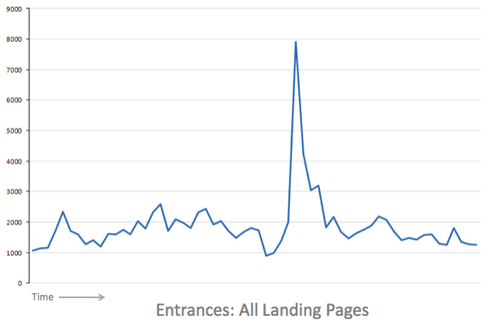
Capacity
How much can you lift?
An appropriate amount, all the time
Load spikes will happen
Don’t be overwhelmed
For example, shed work

Slide 8
A Sample of Patterns
These are a few of my favorites
There are many others
Sources:
Bob Hanmer et al, Bell Labs (5ESS™)
Neil Harrison et al, Bell Labs (Definity™)
Greg Utas et al, Nortel Networks (Nortel Meridian™)
Alan O’Callaghan (consulting with British Telecom and MCI)

Slide 9
Levels of Design
The GoF patterns are low-level design
Classes and objects
Basically at the code level
(“programming hacks”)
Most of these patterns are at a higher level of design (“real” design!)
Some are architectural
Before you write any code
More abstract
Lots of thinking!

Slide 10
Software to Handle Software Errors
Many of these patterns are to handle software errors
… that MIGHT be in the code
We generally don’t use exceptions
… they don’t solve the problem by themselves
And some are to handle hardware errors

Slide 11
Patterns follow …
In the following slides, pattern names are in yellow

Slide 12

Reliability in Memory
Object Pool
For each class, manage a pool of free objects
Define behavior (graceful failure) if the pool is exhausted
May include measures to avoid dangling pointer problems:
Checksum of objects on the free list
Mark and sweep objects to detect orphan objects
C++ only?
the Mars Rover, written in Java!

Slide 13
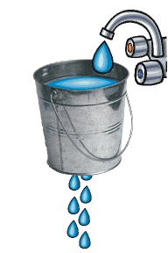
Handling Transient Errors
Leaky Bucket Counter
You can ignore transient errors, but if an error becomes frequent, you must handle it.
(Think hardware faults, for example)
Therefore, Set up a counter:
Periodically increment it up to a maximum.
An error decrements it.
If you hit zero, you have a real error!

Slide 14

Auditing
Routine Audits
Periodically check resource and data integrity
E.g., Phone objects:
If not idle, must be connected to another phone
Run audits in the background
Priority-based OS: audits are lowest priority, the “leisure time manager”

Slide 15
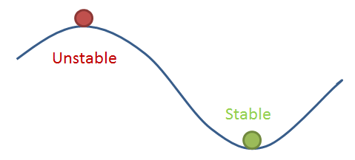
Recovery
Tend to a Stable State
If an error found, put the phone in idle state. Don’t try to recover a “half call.”
A stable state is one from which you can continue to operate
E.g., system running with no phone calls

Slide 16

Infinite Loop Protection
Watchdog
What do you do if your software has an infinite loop?
You want to restart it.
But how do you know? If a process gets stuck, it can’t tell anyone it is sick.
So have a watchdog process
Every few seconds send a message to each process.
Every process must simply respond.
If not, restart the process.
Who watches the watchdog?
(similar to ping-echo)

Slide 17

Priorities…
The watchdog must be allowed to run
If you have a strict priority-based OS (recommended):
Watchdog process is highest priority, but sleeps most of the time.
Windows NT wasn’t
Used time slices for all processes
Newer releases may be different
Linux is

Slide 18

Recovery
Escalating Restart Levels
Define levels of restart, each more serious than the last.
When an error happens, attempt the least disruptive restart that might fix the problem.
If problem persists, move up a level.
Challenge: defining the levels. (Example:)
Re-initialize data tables
Restart some processes
Restart all processes
Restart the operating system
Power down and back up

Slide 19
Performance and Overload Handling
Finish What you Start (Process Stimulus to Completion)
Shed Work at Periphery
Fresh Work Before Stale
Ignore Babbling Idiots
See next slides for details

Slide 20

Finish What you Start
When you begin to process a request, process it all the way to completion:
E. g.: Phone offhook stimulus: process it until dialtone has been applied.
(You must define “stable” states)
Reason: you avoid many issues of concurrency, including performance
Our systems weren’t concurrent

Slide 21
Finish What you Start: Design
The processing must not have any waits for input. (So one definition of “to completion” is “until the next request for input.”)
The processing must be fast. (It usually is)
Define small increments of process stimulus handling
Encourages simplicity (a good thing!)

Slide 22

Shed Work at the Periphery
You are under an overload condition
CPUs are nearly maxed out
Shed incoming work (refuse to process it)
You MUST do it as early as possible – before it hits the CPU.
Offhook: denied at the port board

Slide 23
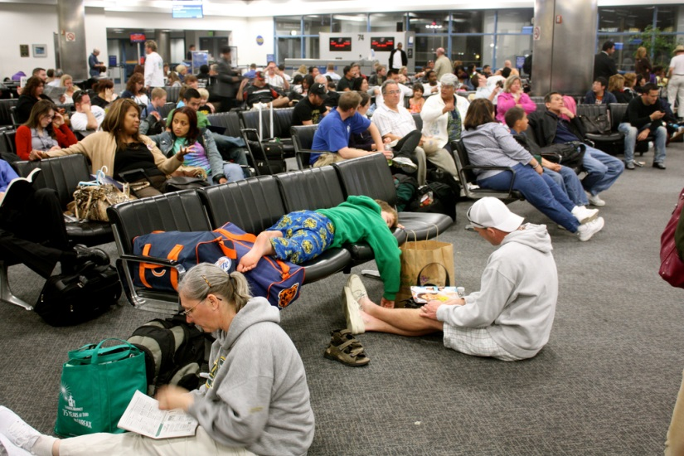
Fresh Work Before Stale
You are overloaded. What work do you do first?
Answer: do the NEWEST work.
This is neither intuitive nor fair!
Why do it?
Work ages. The oldest work is the most likely to be out of date – processing it would be a waste of time.
Airlines do this: they load confirmed passengers before bumped passengers. (Annoy the passengers who are already mad!)

Slide 24

Ignore Babbling Idiots
Hardware (or software) problems can cause a stream of spurious requests.
Processing them, even rejecting them, can eat up all your processing time!
Set a frequency threshold, well above normal activity
If a device exceeds it, ignore that device until it is repaired.

Slide 25
Distribution
Creates two major headaches for robust systems:
Reliability
In particular, correctness – distribution introduces opportunities for errors
Performance
Two patterns to help:
Homogeneous Distribution
Half-Object Plus Protocol (HOPP)

Slide 26
Distribution Options
Distribution of functionality (heterogenous:)
Different systems do different things
Easy to do, but has problems:
Limited scalability
Limited survivability
Bottlenecks
Multiple Software Loads
High coupling (dependencies)

Slide 27
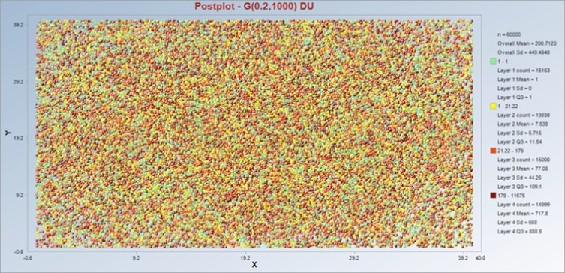
Homogeneous Distribution
Move subscribers (load) to different processors.
All systems are the same, just run on different data sets
Near-linear scalability
Survivability: affects only a subset of clients
One software load
Strong cohesion: all data for a client in one place

Slide 28
In distributed transactions, remote information is needed
Heterogeneous distribution: Send requests to a name server to get destination
Common approach (see DNS servers)
But it can be expensive and unreliable

Slide 29
Use Homogeneous Distribution
And replicate part of the data on each system
For example, the name server’s database
Local requests can be handled completely locally
Remote requests handled efficiently

Slide 30
Advantages:
Messaging costs
Timeouts (don’t have to deal with them)
Latency
Transient states (not needed)
Disadvantages:
Memory usage
Transient data (local data out of sync)
Complexity (how to replicate/update data, and handle outdated data)

Slide 31
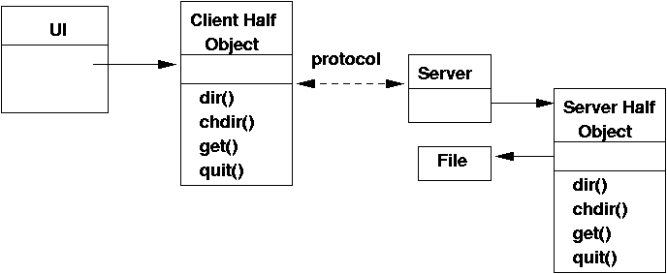
Half-Object Plus Protocol (HOPP)
It’s natural to model a Phone Call as an object
But you run into all sorts of problems:
Dynamic behavior: conferences, call forward, etc.
Connection types: M x N explosion
Distributed vs. local calls (not transparent)
Let’s try using a Call object to design each…

Slide 32
HOPP
Therefore:
Model a call as three parts: Two half calls plus the connection (protocol) between them
Solves the M x N explosion problem
Distributed calls are (almost) transparent
Dynamic features are easier

Slide 33
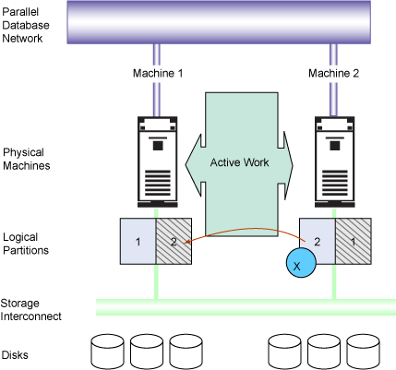
Failover
Load Sharing
N + M Sparing
Cold Standby
Warm Standby
Hot Standby

Slide 34
Standby Flavors
Cold: ready to start up
Slow, hard to pick up the work where it left off.
Warm: running, but not up to date with all the transactions
Fast, still hard to pick the work up (start at a stable state)
Hot: running, and shadowing the work
Very fast, usually seamless
Careful: you might shadow the software bugs!

Slide 35

Patching/Upgrading
How do you change the tires on a car going 60 MPH?
Rolling Upgrade
Take parts out of service, upgrade them, bring them back
Hitless Upgrade
Upgrade the Hot Standby; when it syncs with the Active, swap them

Slide 36
Summary: Key Patterns
Leaky Bucket Counter
Tend to a Stable State
Watchdog
Escalating Restart Levels
Finish What you Start
Fresh Work Before Stale
N + M Sparing
Hot Standby

Slide 37
Availability Tactics
From Bass, Clements, & Kazman: “Software Architecture in Practice”, Addison-Wesley, 2003.
Tactics: similar to patterns (terminology wars!)
But not written as patterns, e.g., no exploration of forces
Significant overlap with other material

Slide 38
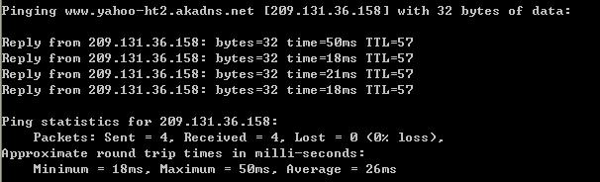

Fault Detection Tactics
Ping/Echo
Heartbeat
Exceptions

Slide 39

Tactics of Recovery: Preparation and Repair
Voting
Active Redundancy
Passive Redundancy
Spare

Slide 40

Tactics of Recovery: Reintroduction
Shadow
State Resynchronization
Checkpoint/Rollback

Slide 41
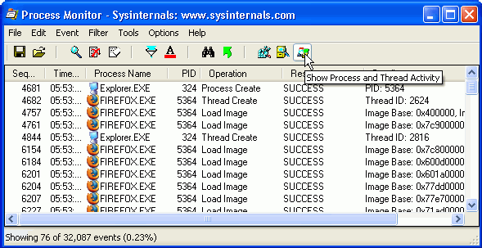
Prevention
Removal from Service
Transactions
Process Monitor

